Slide 1
Koodoo Data Science Task
David Brookes
January 2021

Slide 2
Exercise Solutions
Answer 1.
There are 16 columns in the data set. However, ‘price’ can be assumed to be the dependent variable, and ‘property_id’ can be changed arbitrarily and therefore is not a reliable feature. Hence there are 14 independent variables (features).

Slide 3
Answer 1 continued
‘host_since’ represents time. It is discrete and ordered and can be described as being an ordinal variable.
‘host_is_superhost’ is a boolean variable. It is discrete and unordered, and can be described as a nominal variable (or even as a binary variable).
‘room_type’ is discrete and unordered, and therefore a nominal variable.
‘bedrooms’ is discrete and ordered, and is therefore an ordinal variable.
‘price’ is discrete and ordered, and can be described as being an ordinal variable. However, ‘price’ could also be considered to be a continuous variable, where values can in theory fall anywhere on a continuum.

Slide 4
Answer 2.
The two most correlated variables are ‘beds’ and ‘bedrooms’ with a correlation coefficient of 0.999971.
Answer 3.
The two least correlated variables are ‘price’ and ‘minimum_nights’ with a correlation coefficient of -0.000687 (note that this has the smallest absolute value).

Slide 5
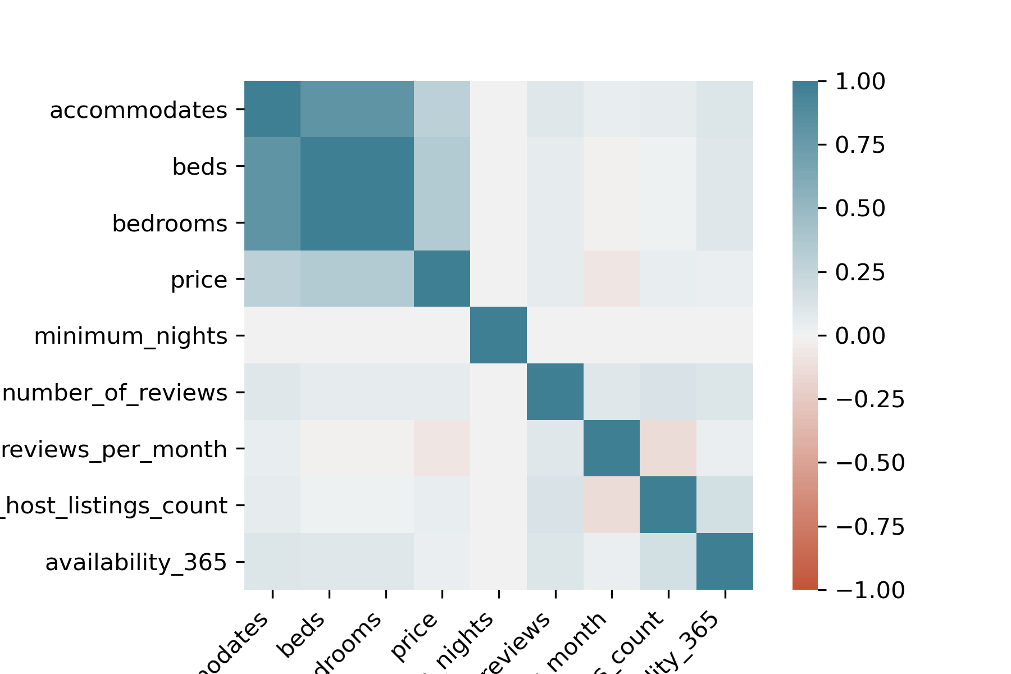
Answer 4.

Slide 6
Answer 4 continued
The most relevant attributes are the ones that are highly correlated with ‘price’, namely ‘accommodates’, ‘beds’ and ‘bedrooms’ (0.289, 0.336 and 0,336 respectively). These three attributes can be used as features when fitting a model. Note that ‘beds’ and ‘bedrooms’ are very highly correlated and that one of these could be dropped as a feature. (The variance inflation factor would be large if a multi-linear regression model was fitted).

Slide 7
Answer 5.
The following histograms show the distribution of prices for each state, and room type. Note that two price bands (below and above $1000) have been considered in order to make clearer the distribution of the more higher priced accommodation, rather than just plotting one histogram for the entire price range. (The ‘price ’ variable could of course also be transformed, e.g. log(price) could be used ).

Slide 8
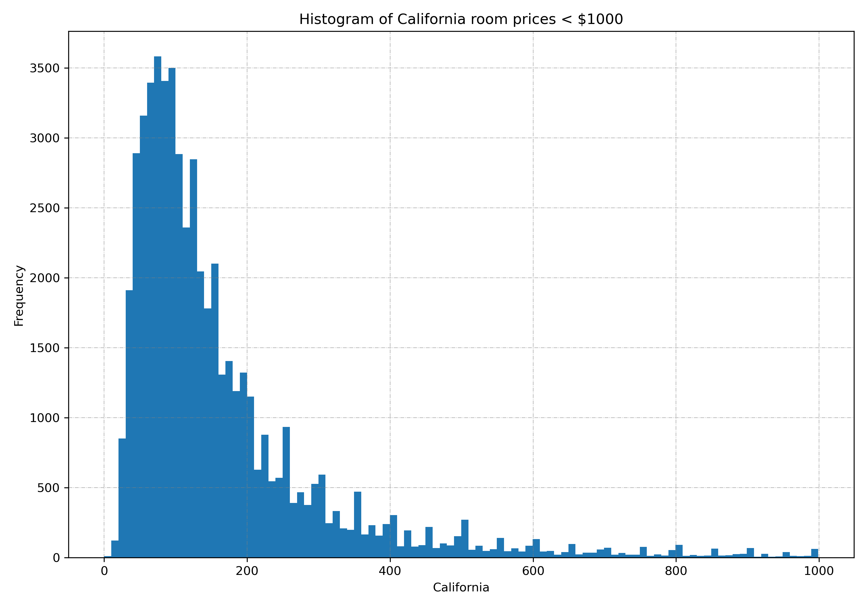
Price Distribution by State

Slide 9
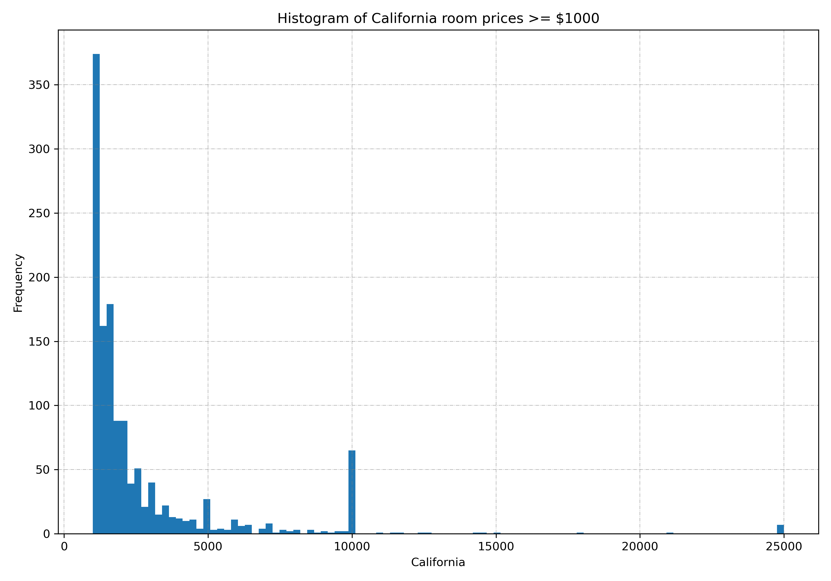

Slide 10
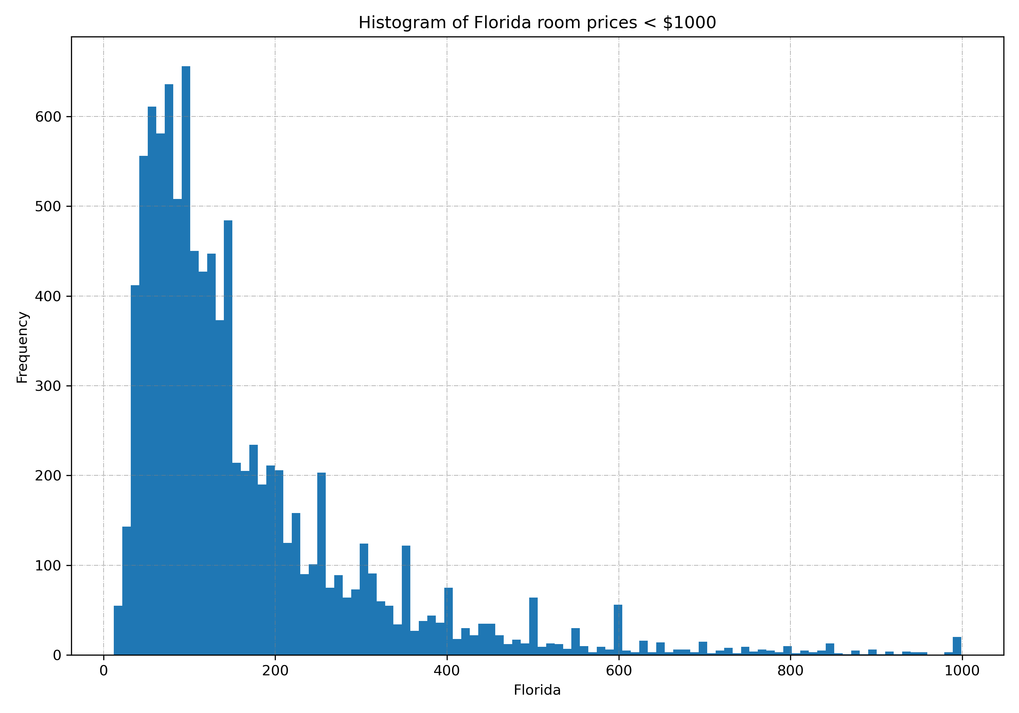

Slide 11
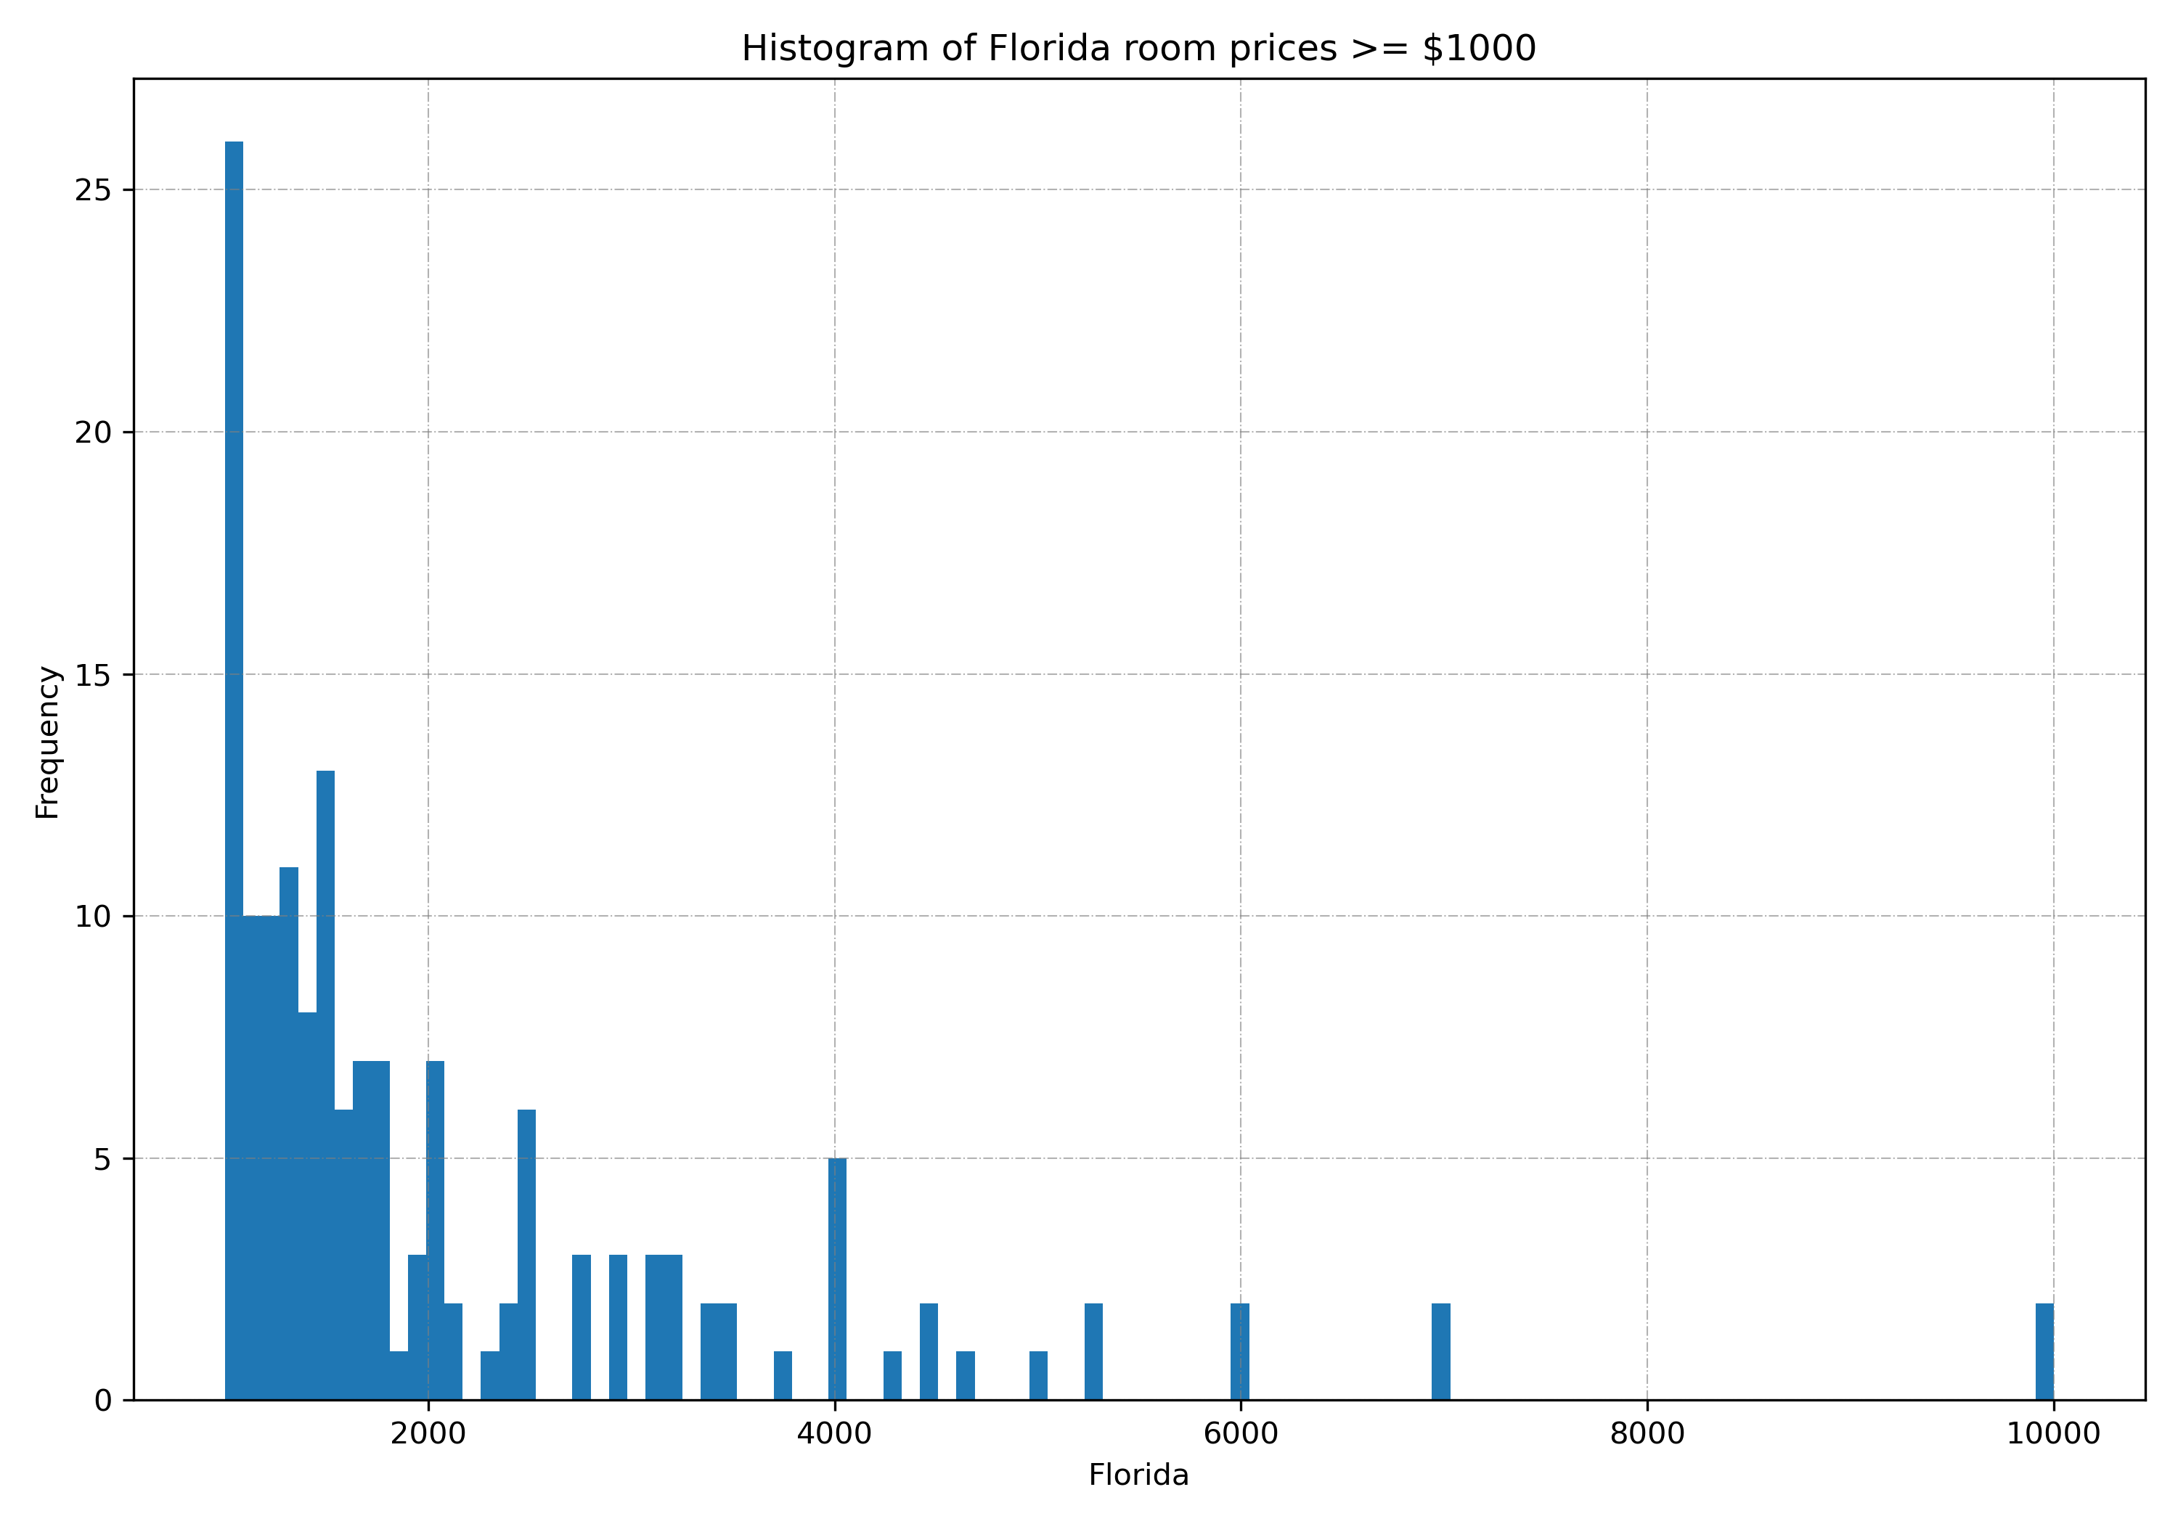

Slide 12
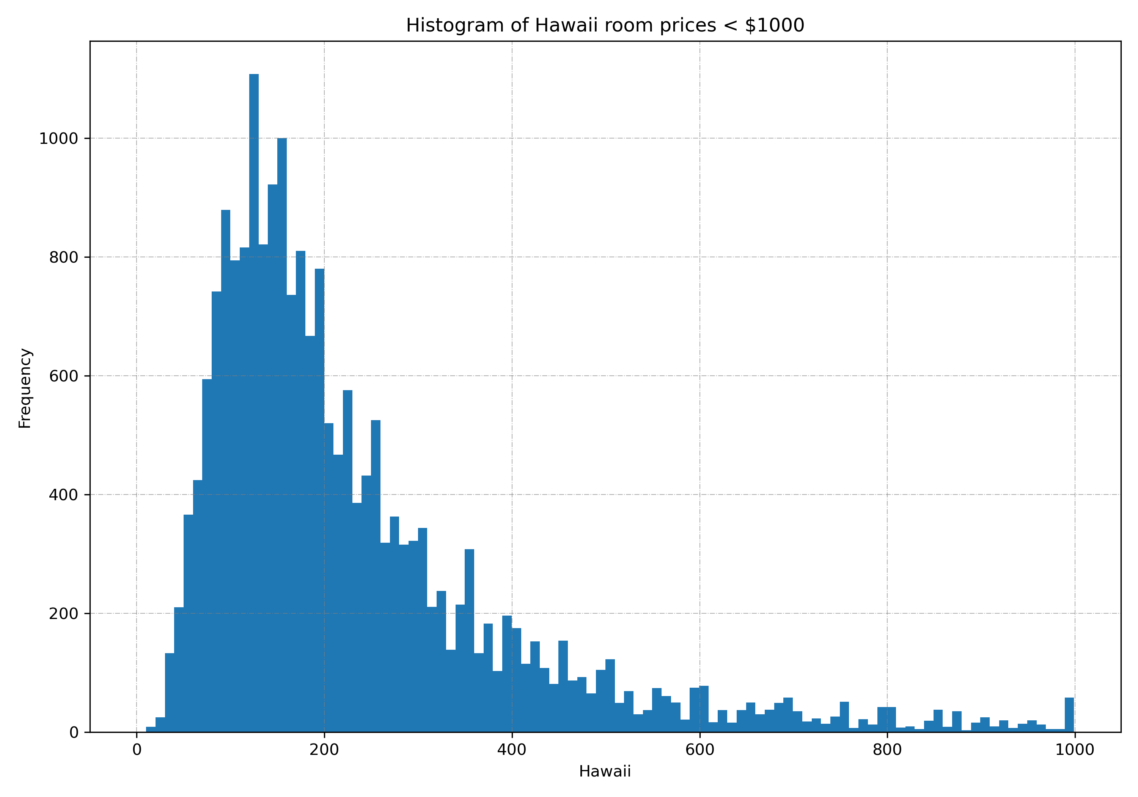

Slide 13
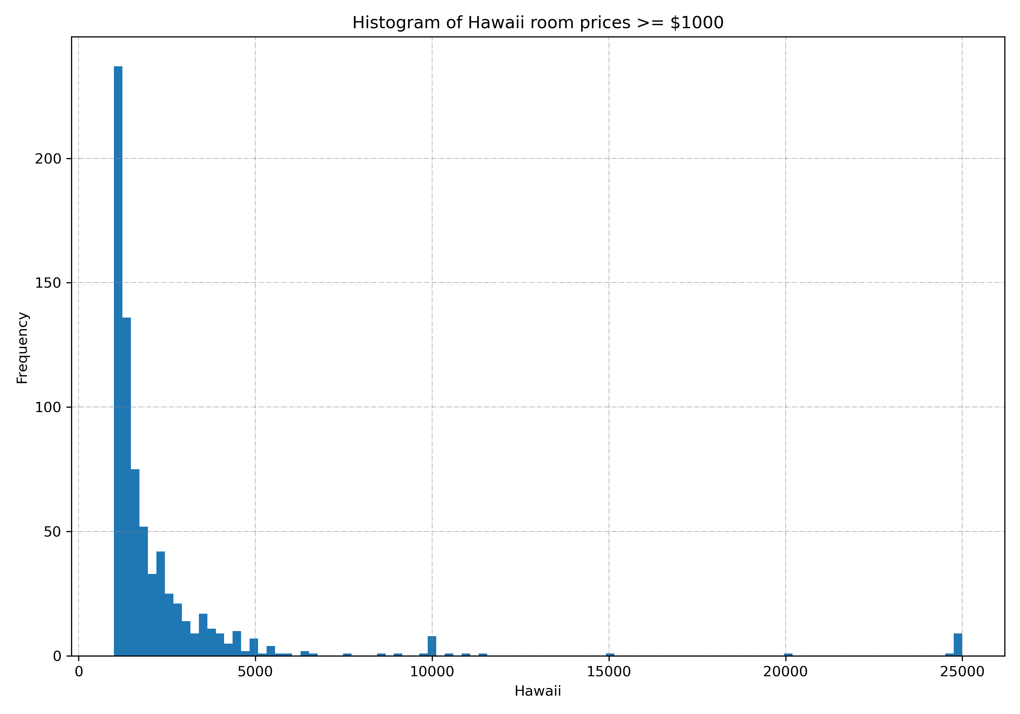

Slide 14
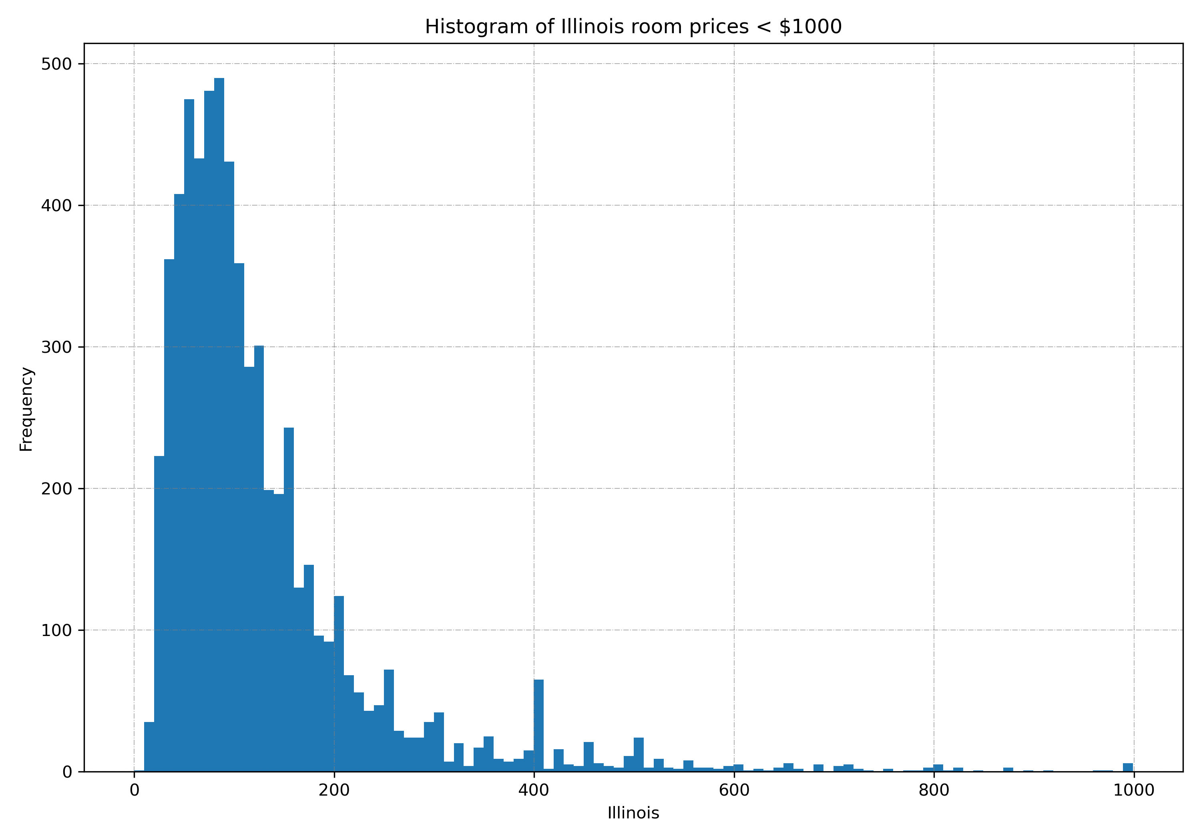

Slide 15
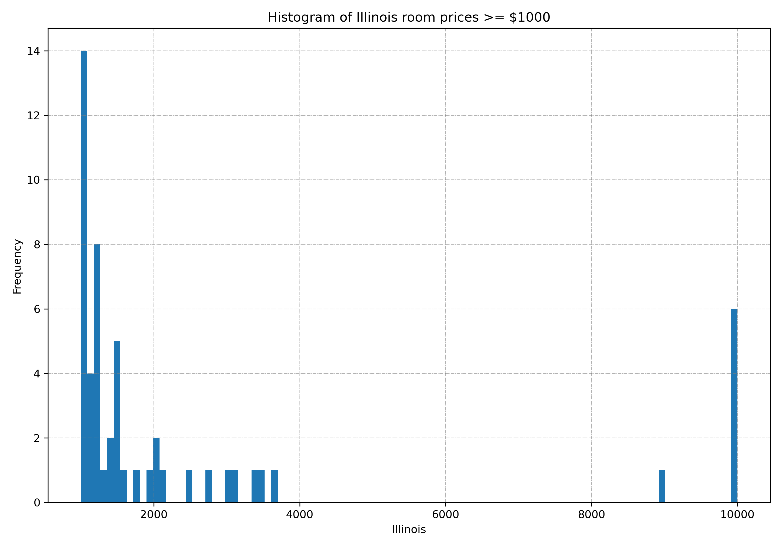

Slide 16
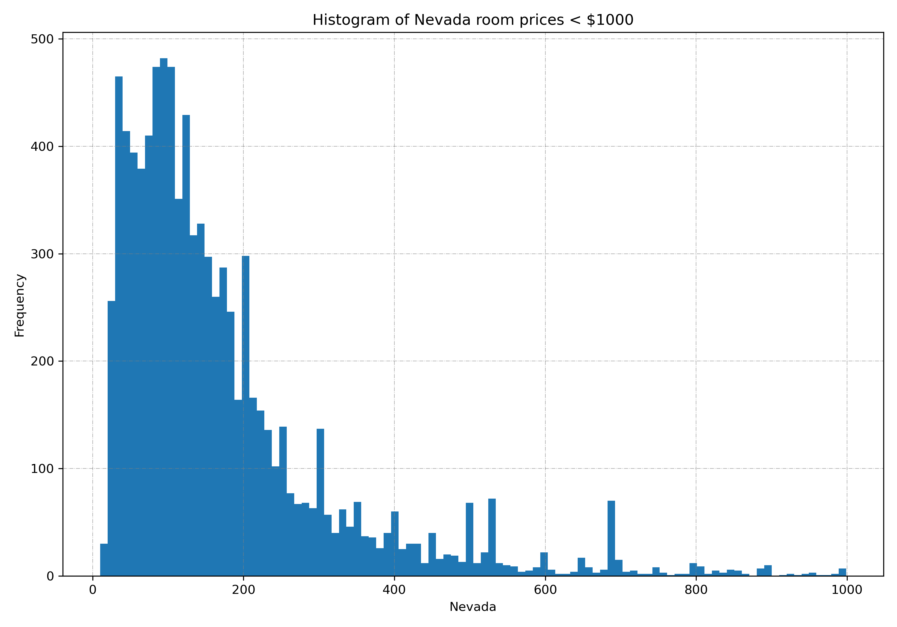

Slide 17
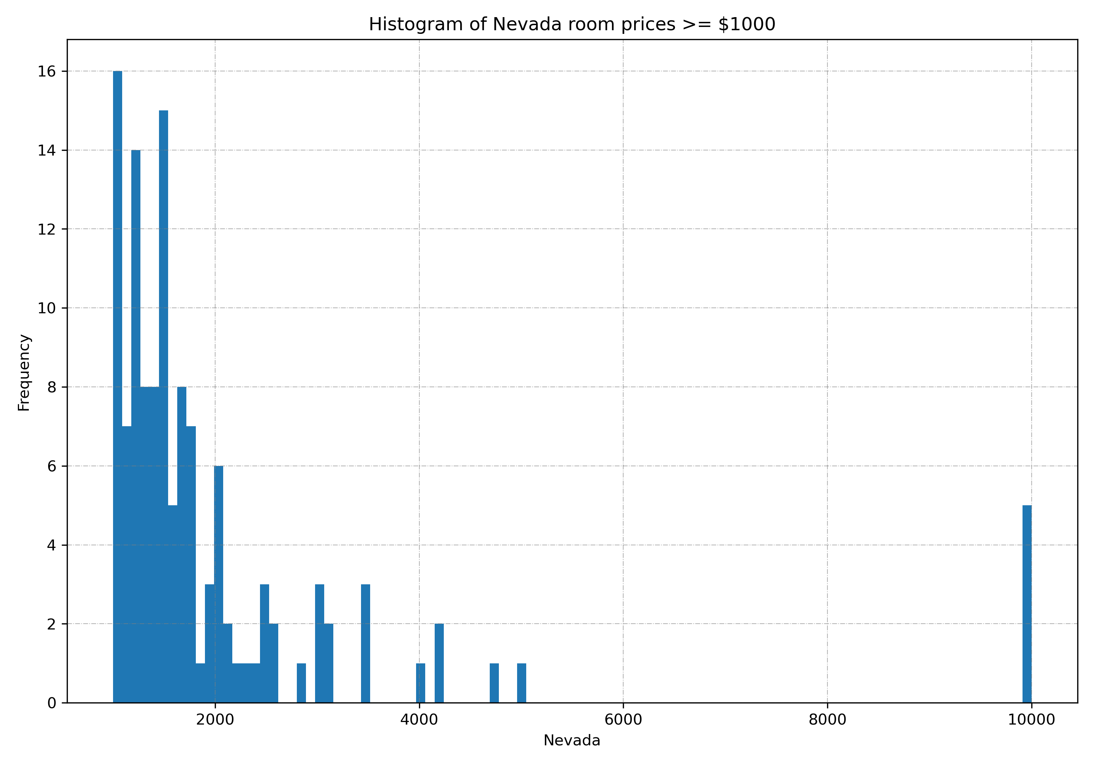

Slide 18
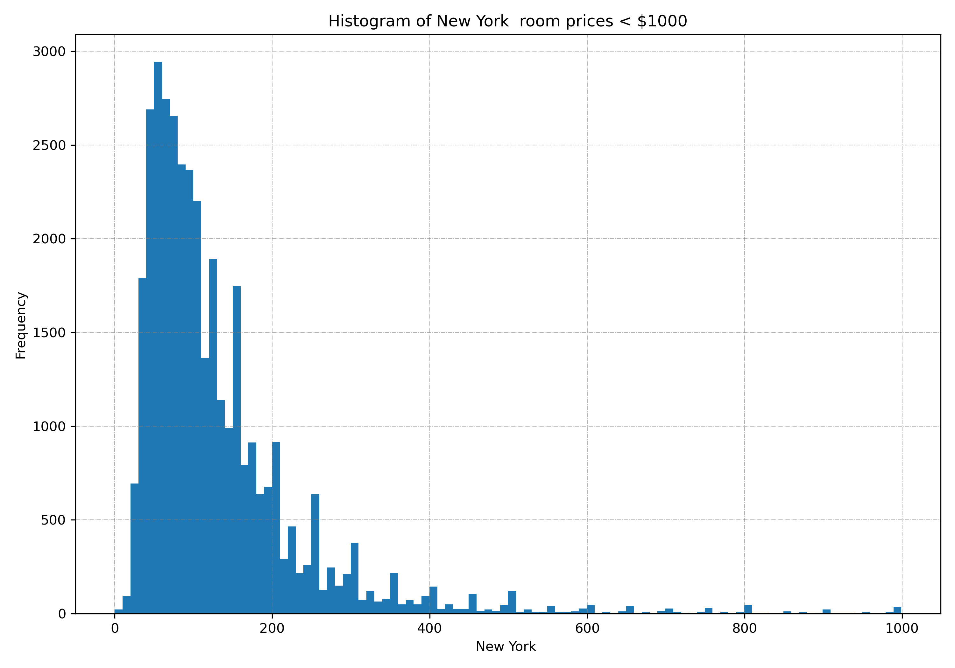

Slide 19
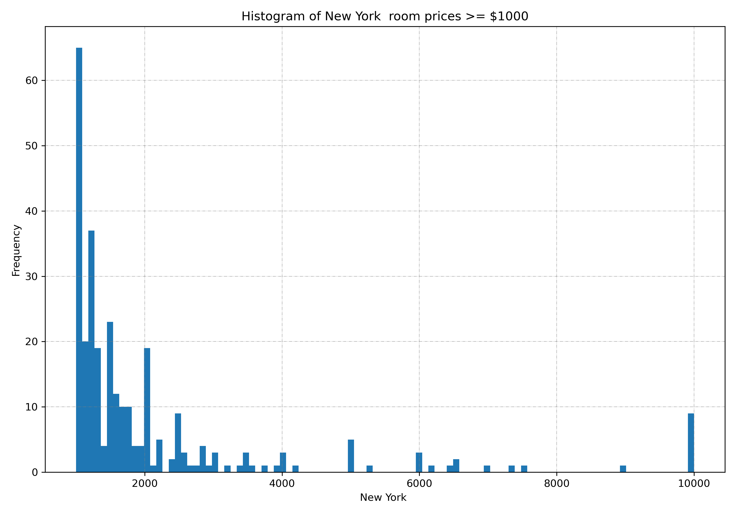

Slide 20
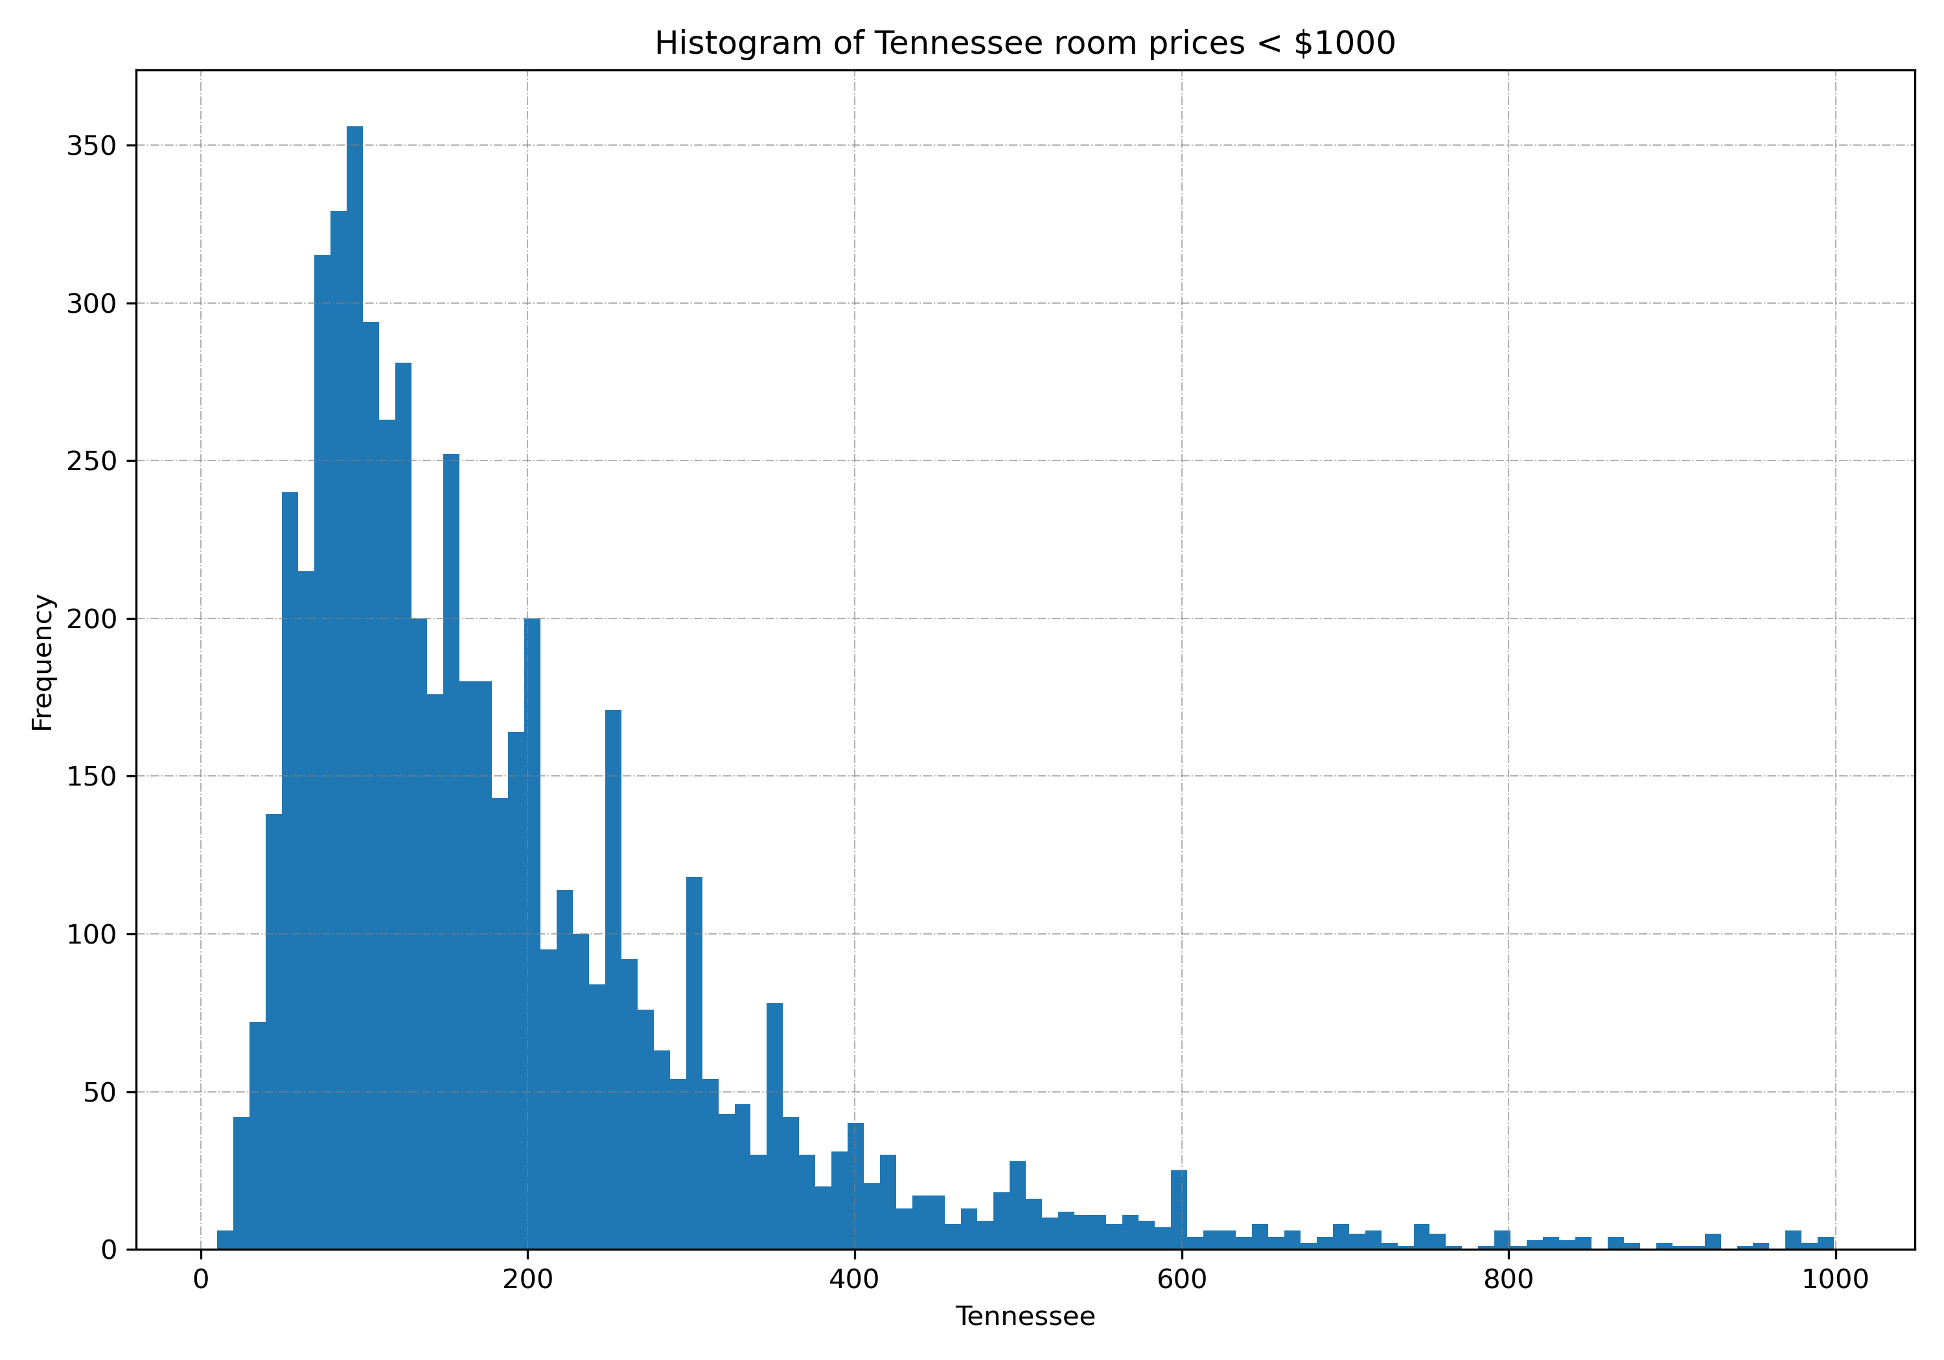

Slide 21
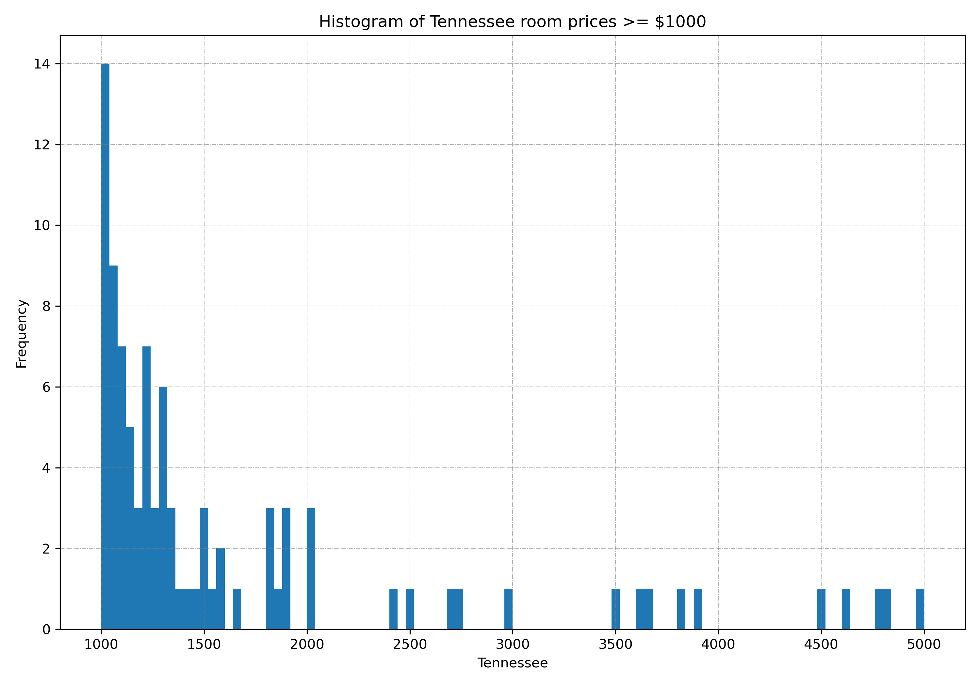

Slide 22


Slide 23
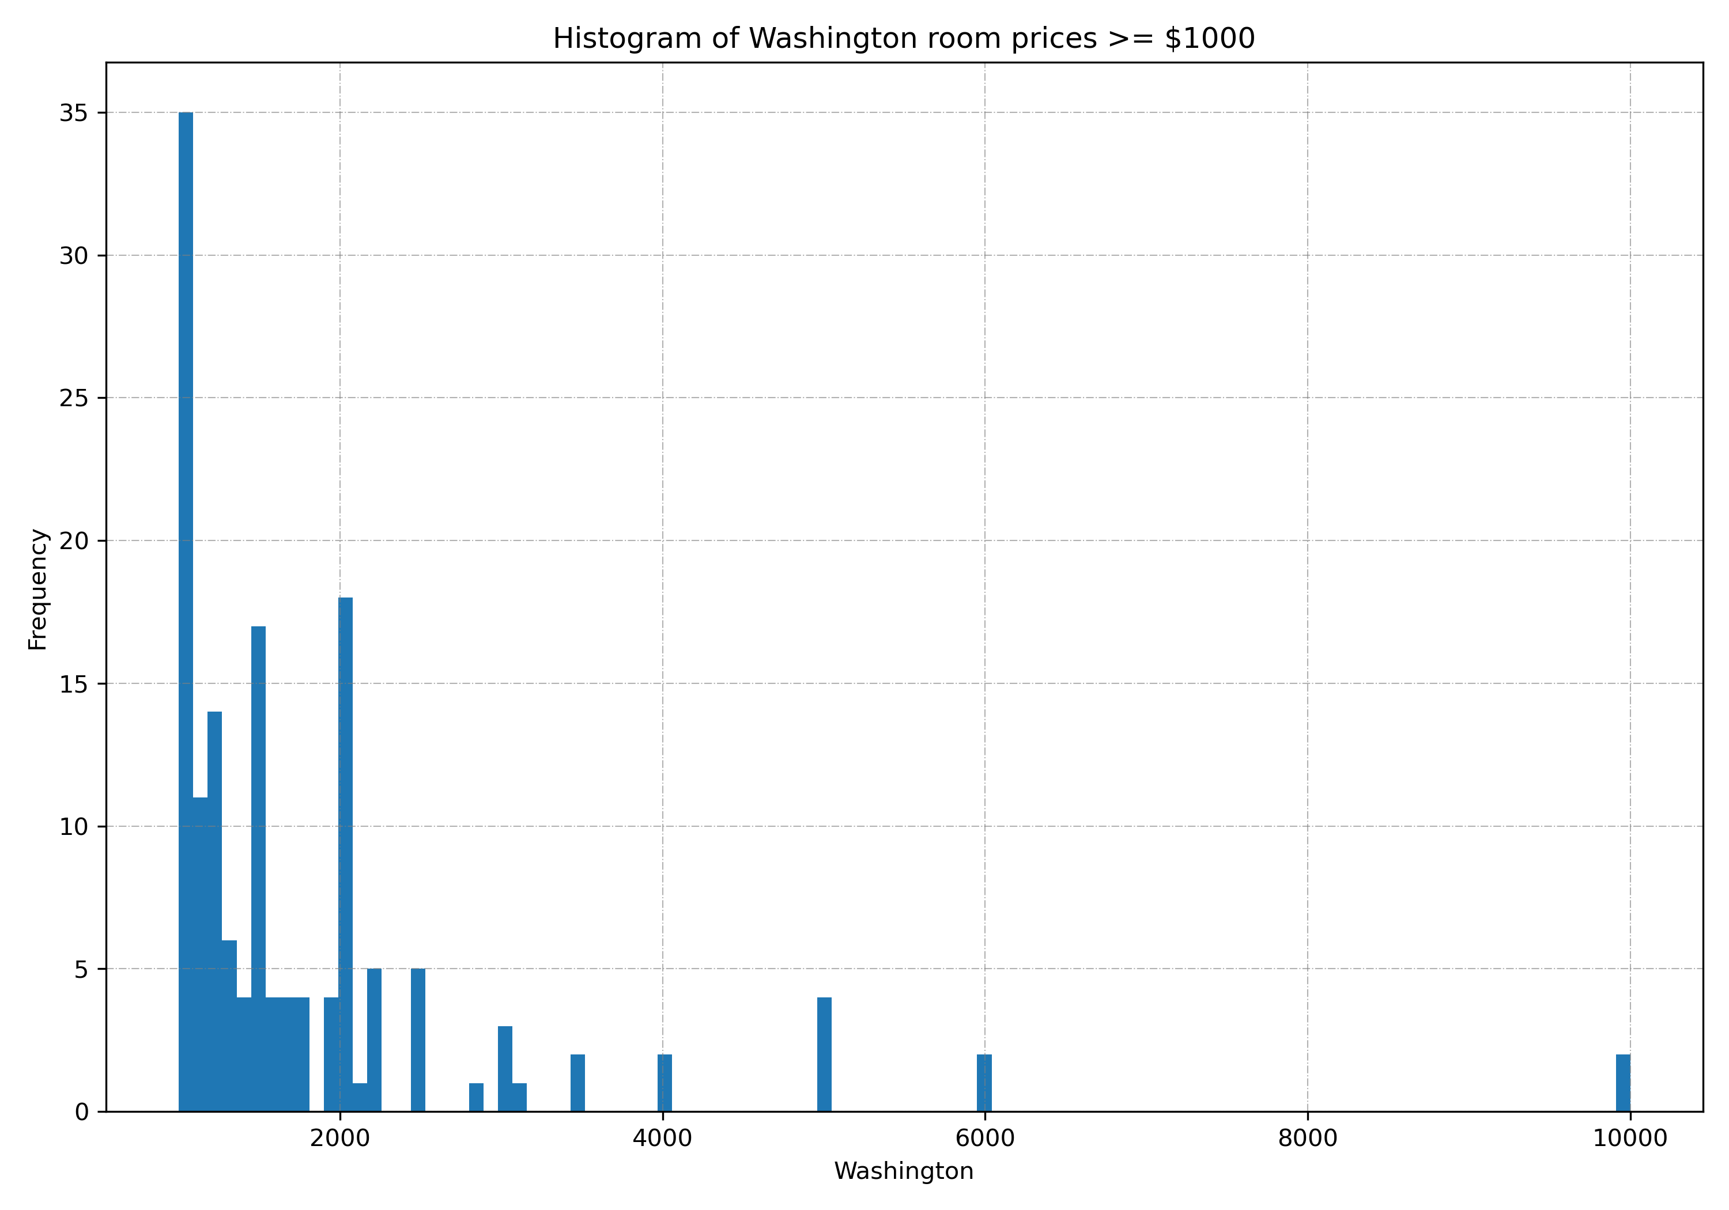

Slide 24
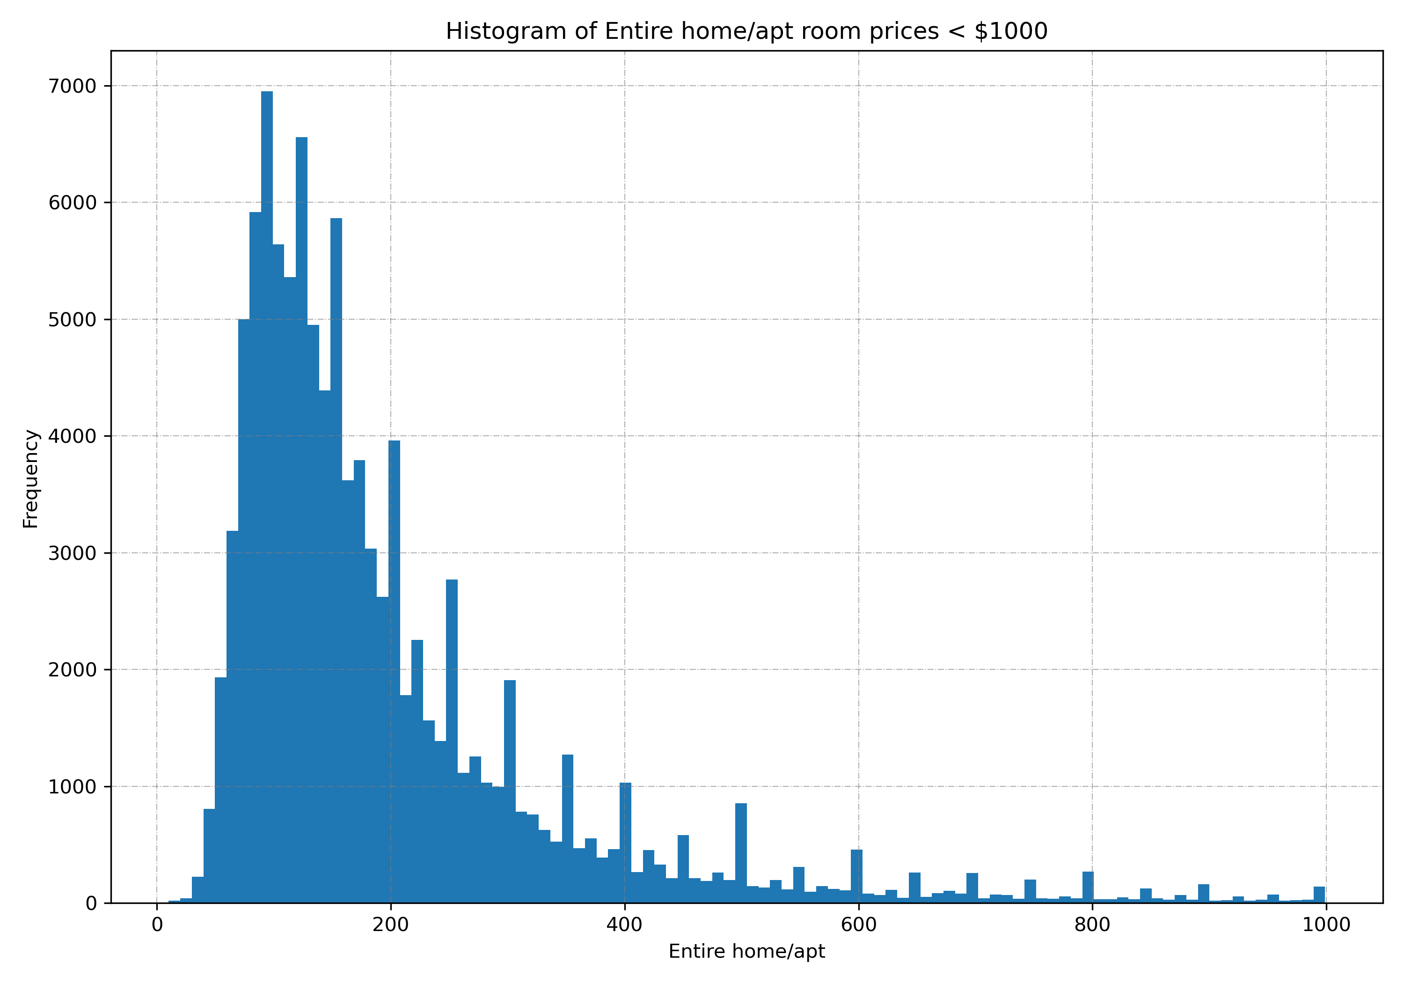
Price Distribution by Room Type

Slide 25
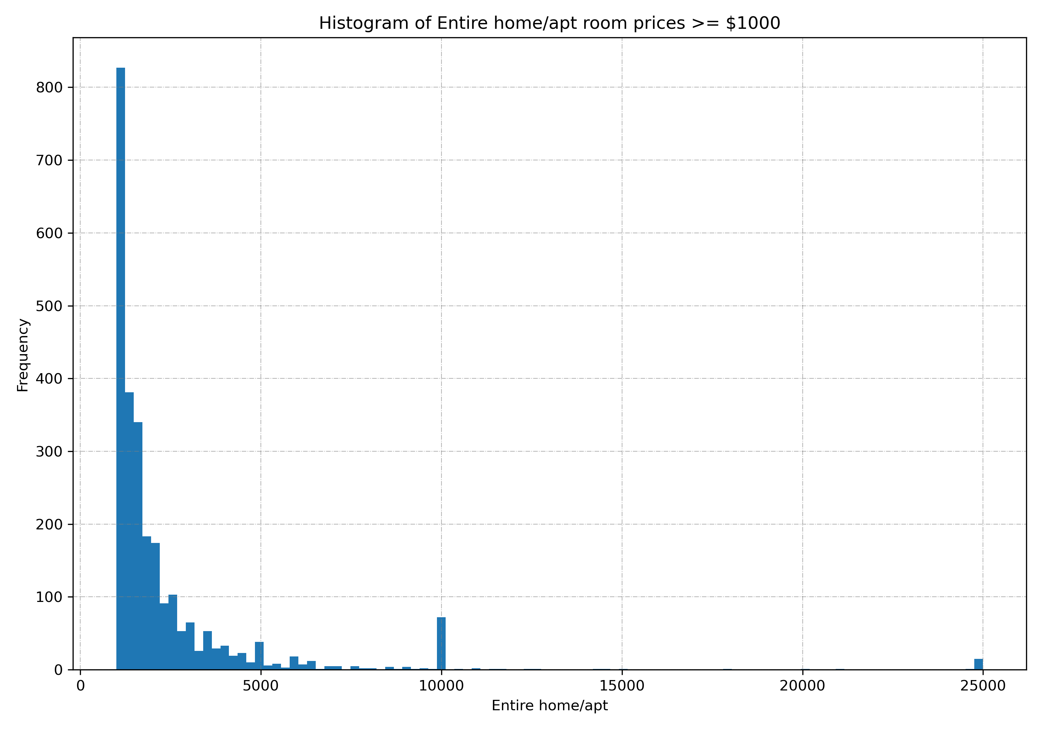

Slide 26
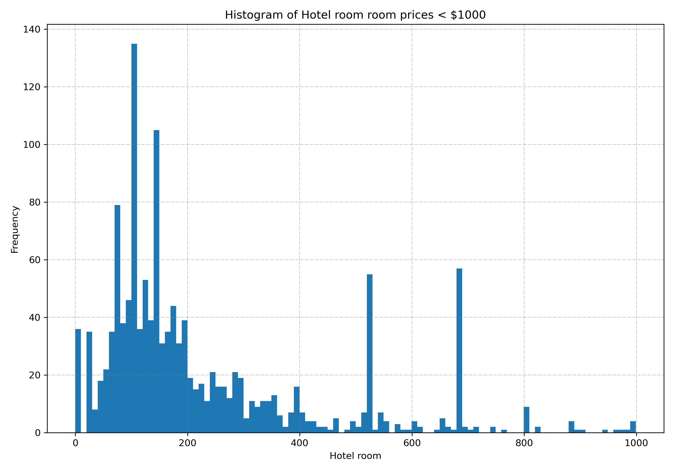

Slide 27
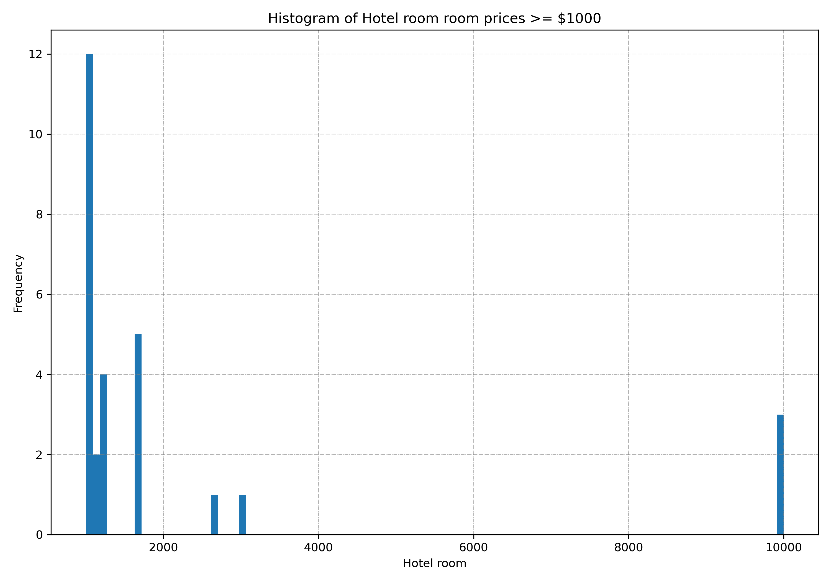

Slide 28
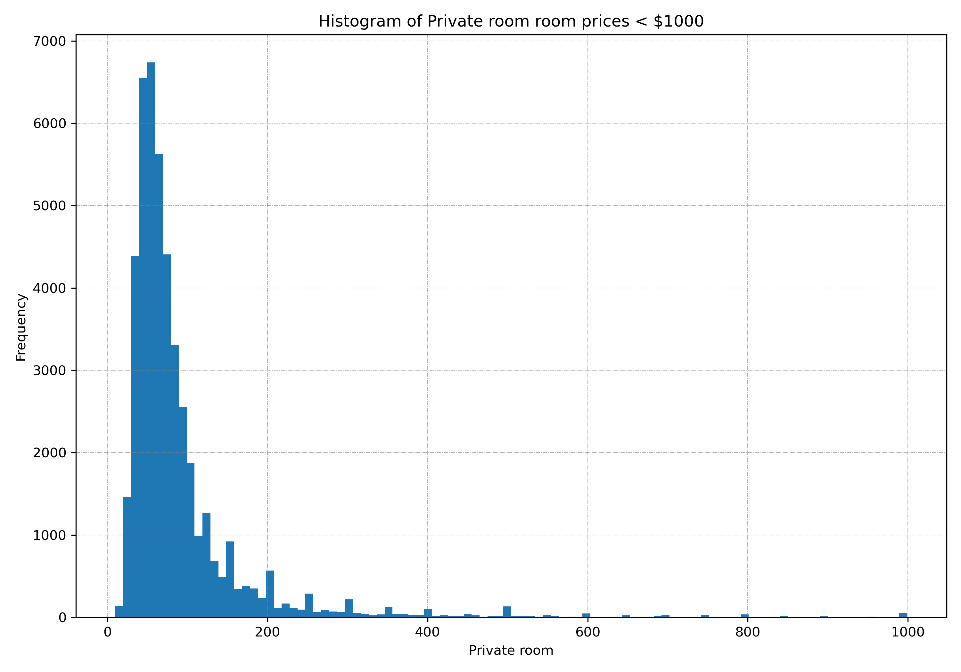

Slide 29
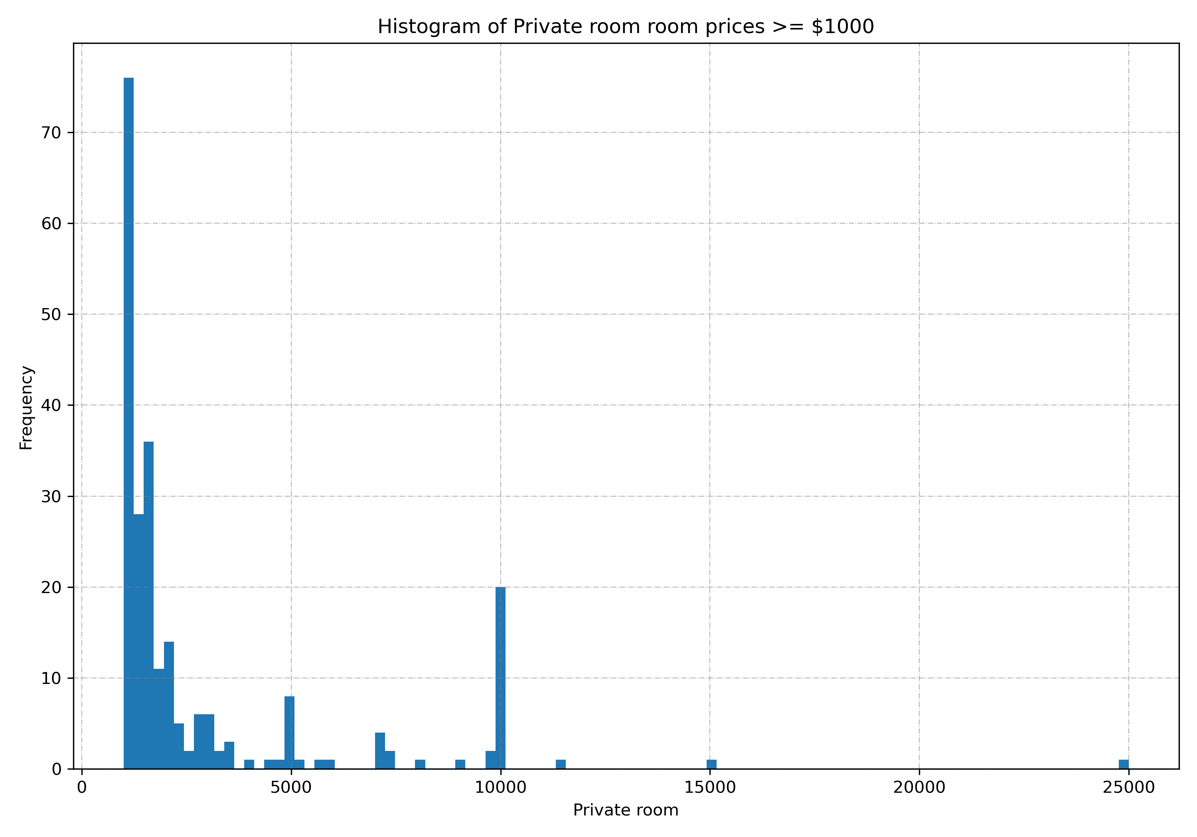

Slide 30
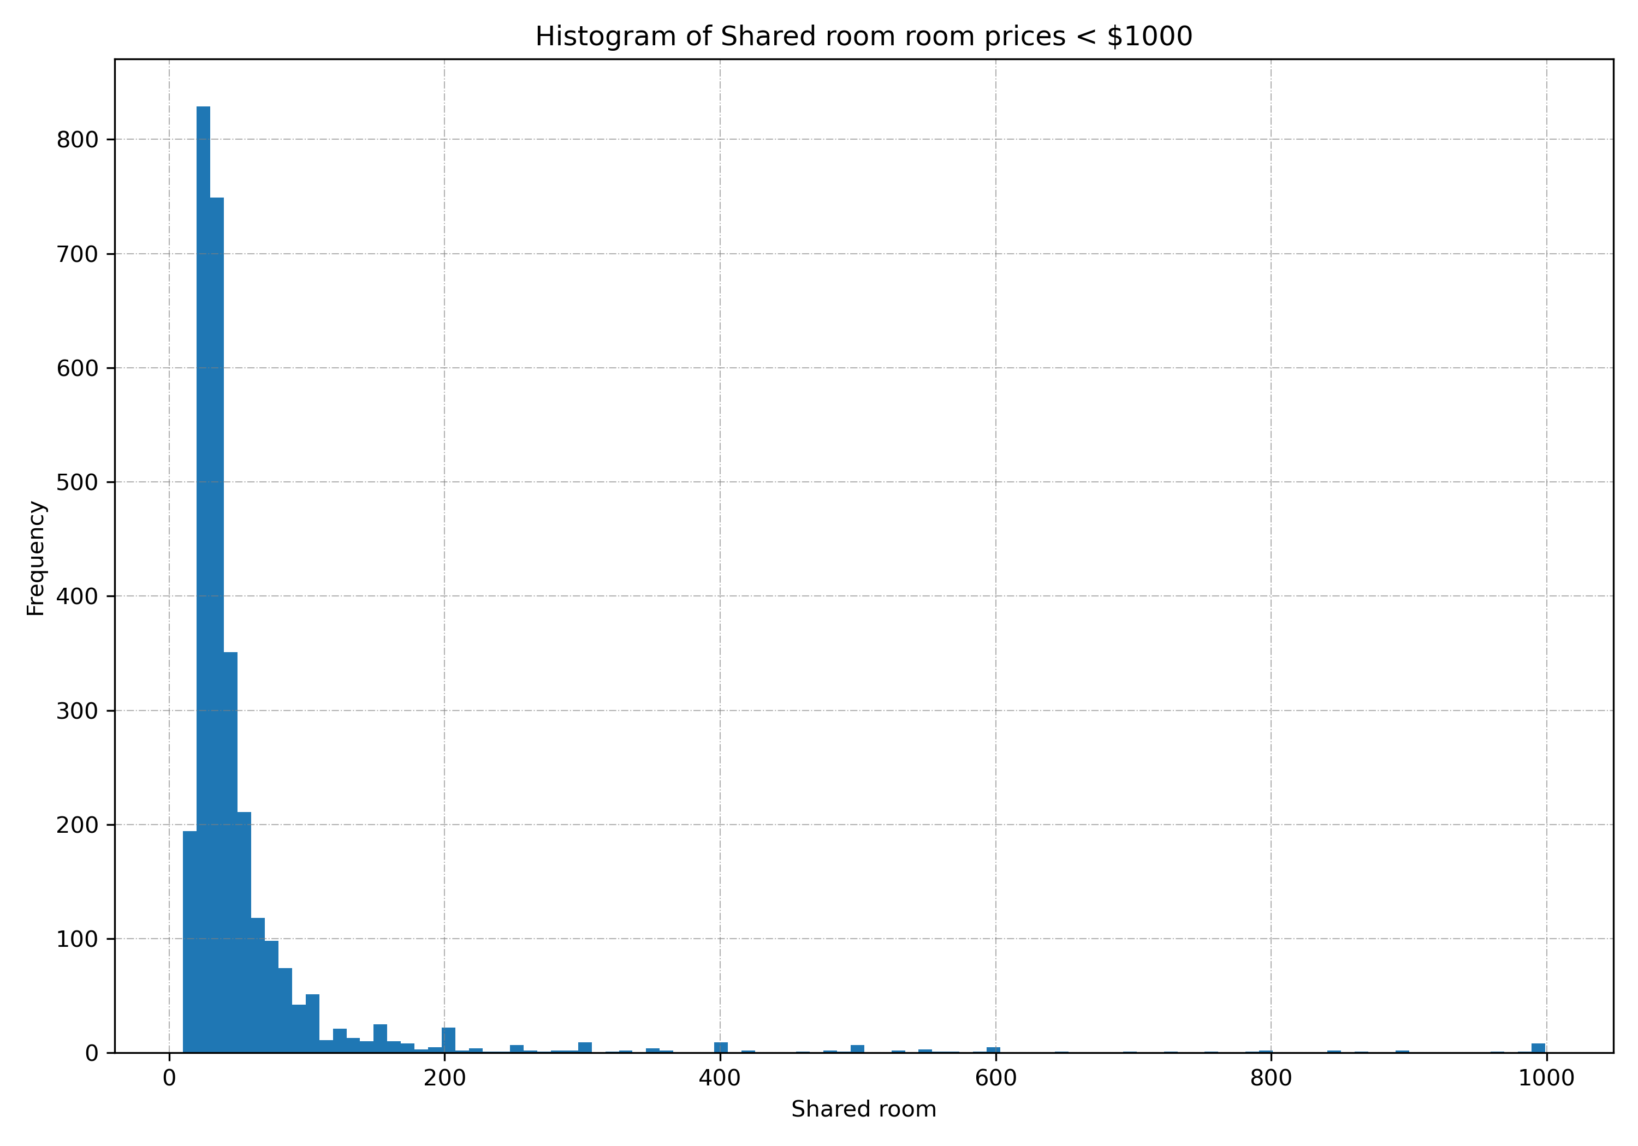

Slide 31
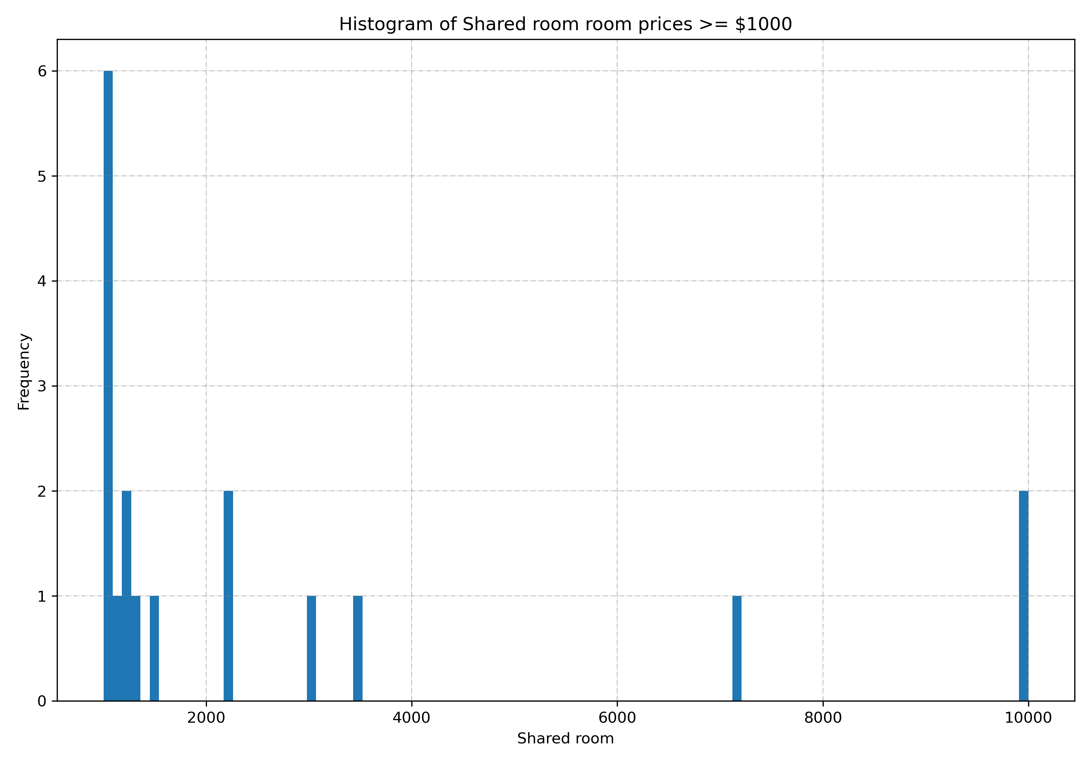

Slide 32
End of Presentation

